Slide 1
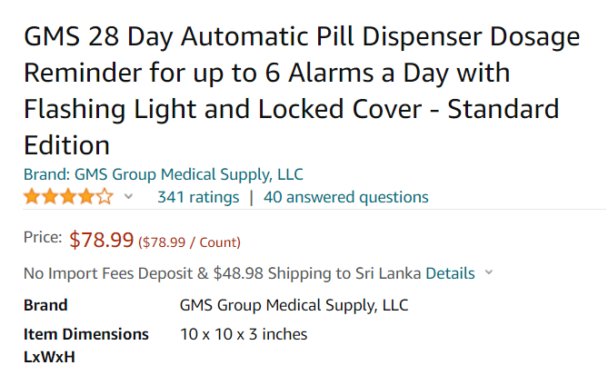
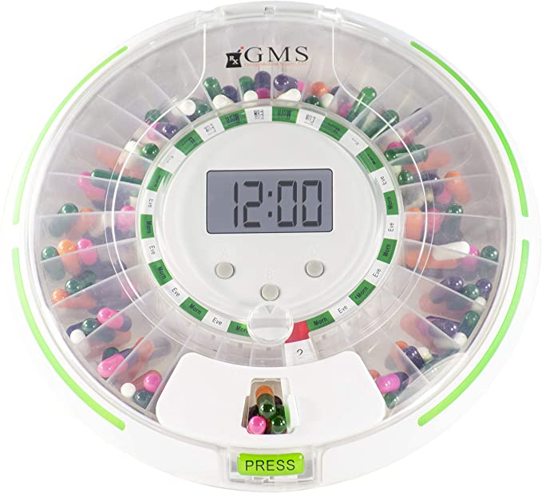
Medi Tab
Automatic medicine tablets distribution and reminder with IOT control monitoring
every patients who take medicine for their diseases. They cannot take medicine continuously because they forget; old persons or uneducated people do not know the name of medicines. so, this type of medicine holder system remind them and give correct tablet with correct quantity.
some patients have every month checkup. Doctors ask patients , “do you take tablet continuously". Sometimes patients tell lies, so in this device maintain data of tablets details ,taking time and quantity in server so doctor easy to confirm that
In this device three types of reminders. there are normal alarm , sim SMS and email
If any tablet is in low quantity or the patient does not take medicine continuously, this device send alert to responsible person about the situation.
In market, this type of devices have only reminders with high cost. they do not have IOT part and data servers

Slide 2
Estimation of cost(prototype)
 | no | cost
Servo motor | 2 | 760
lcd | 1 | 900
Atmega328p/2560(Arduino) | 1 | 500
Esp01/nodemcu v3 | 1 | 800
keypad | 1 | 200
speaker | 2 | 800
Real time clock | 1 | 340
Enclosure |  | 2000
Voltage sensor
PCB design |  | 1500
Total cost =8500.00
Normally I use online IOT platforms. If I have extra time ,I will try to design website for multiple users to get details(like social medias, if anyone buy product, we generate new username and password for him or her.

